Slide 1
Resume bank
GATE and tika container

Slide 2
Technology & Platform
Platform: React JS, Java, Spring Boot, File system
Documents: Architecture Diagram, Flow Diagram
Plugins: GATE container, Apache TIKA parser

Slide 3
Points Covered
Flexible UI to search and add multiple resumes in react environment.
File system is used to save render resumes.
GATE container with apache tika is used to read and parse files.
We can download matched resume as file and as well a JSON in the UI.
It supports many file formats like pdf, docx, etc.

Slide 4
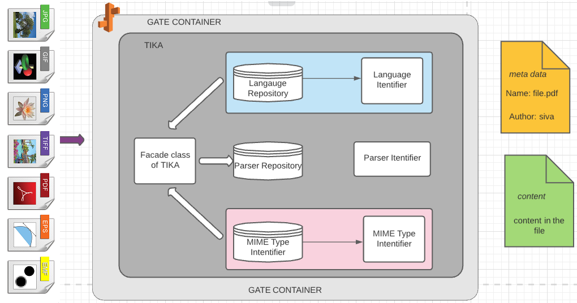
architecture diagram

Slide 5
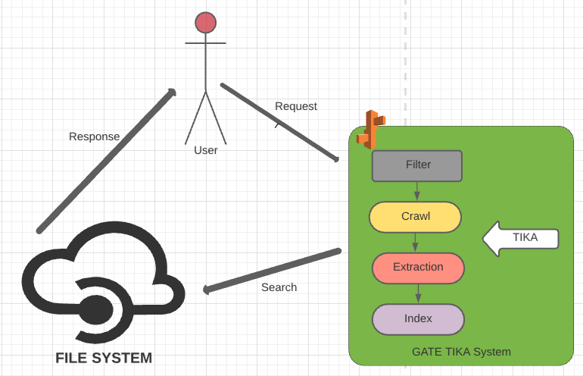
Flow diagram

Slide 6
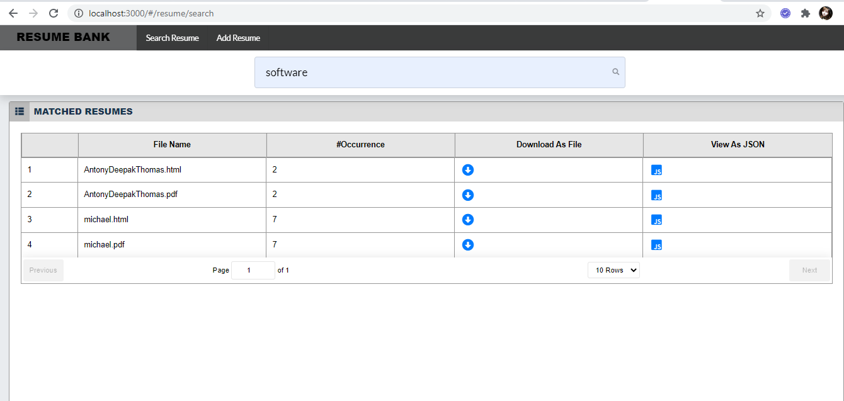
Resume search screenshot

Slide 7
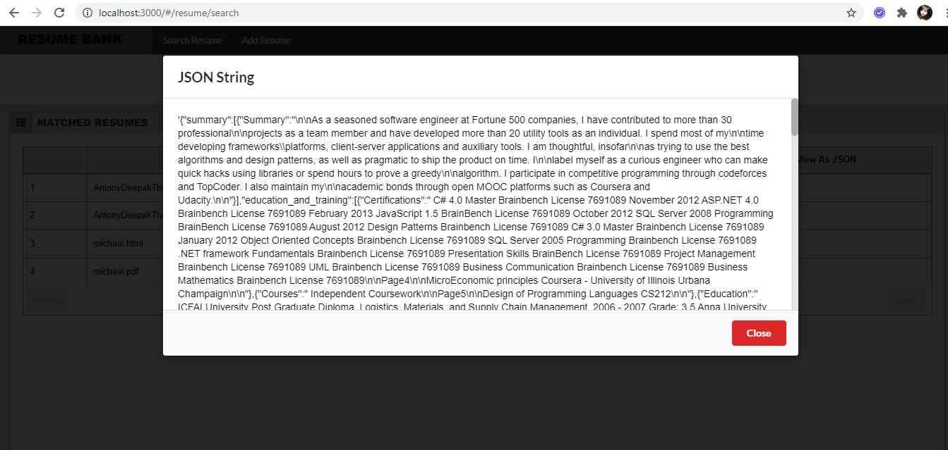
Json download screenshot

Slide 8
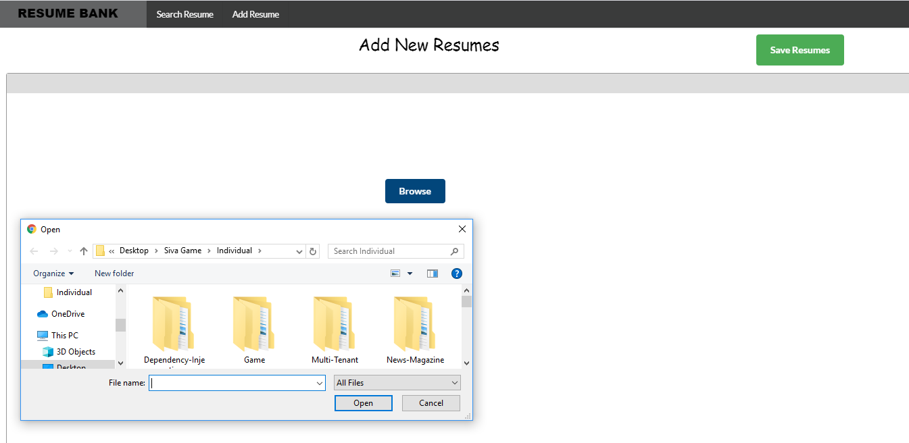
Add resume screenshot

